Slide 1

OOP -
Inheritence

Slide 2
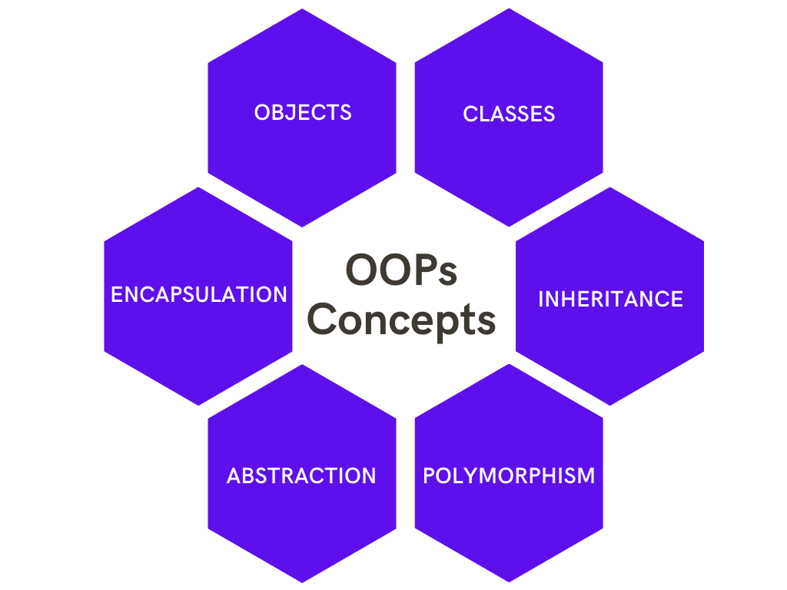

Slide 3
Inheritence nima?
Inheritence – bir class modelining imkoniyatlarini, boshqa bir classda ham ishlata olish imkonini beruvchi OOP prinsipidir.

Slide 4
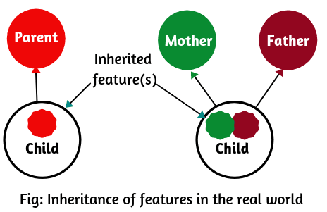

Slide 5
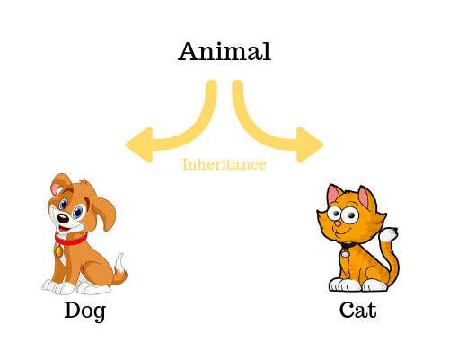

Slide 6
A
Single Inheritence
B

Slide 7
A
B
Multilevel Inheritence
C

Slide 8
A
B
C
D
Hierarchical Inheritence

